Slide 1
Discussion 6: Intro to Asymptotics And Bits
Christine Zhou

Slide 2
Agenda
Announcements
And time to fill out surveys
Asymptotics Review
Problem 1,2
Bits and Bitwise Operators
Problem 3

Slide 3
Announcements
Midterm grades to be released soon!
Likely by Wednesday...
Start Project 1 if you haven’t already. Read through the spec by the end of the day today.
(PLEASE FILL OUT TODAY) Discussion survey: tinyurl.com/cz-disc6-fa18

Slide 4


Asymptotics: Big Ө(...)
Called “big theta notation”
R(N) = runtime, f(N) = function, k’s = constants
The runtime can be both upper and lower bounded by the function
Let’s say R(N) = 3n³ + 2n² + 1
What is a good f(N), k₁, k₂?
f(N) = n³, k₁ = 2, k₂ = 4

Slide 5


Asymptotics: Big O(...)
Called “big oh notation”
R(N) = runtime, f(N) = function, k = constant
The function is an upper bound on the runtime
DOES NOT MEAN WORST CASE
True or false?
N² ∈ O(N²)
N² ∈ O(N⁵⁰⁰)
N log N ∈ O(N)
log N ∈ O(N²)

Slide 6
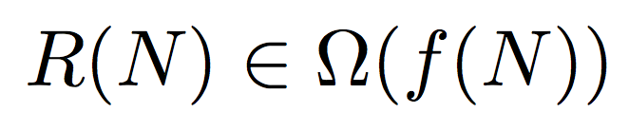
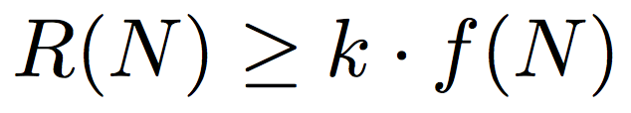
Asymptotics: Big Ω(...)
Called “big omega notation”
R(N) = runtime, f(N) = function, k = constant
The function is a lower bound on the runtime
DOES NOT MEAN BEST CASE
True or false?
N² ∈ Ω(N²)
N ∈ Ω(1)
N² ∈ Ω(N³)

Slide 7
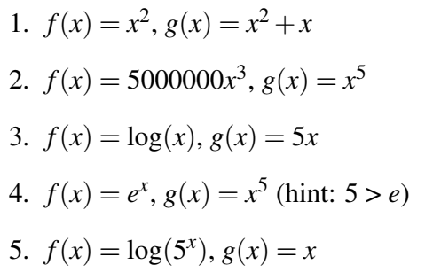
1 Basic Algorithmic Analysis
Solutions:
f ∈ 𝛳(g)
f ∈ O(g)
f ∈ O(g)
f ∈ Ω(g)
f ∈ 𝛳(g)

Slide 8
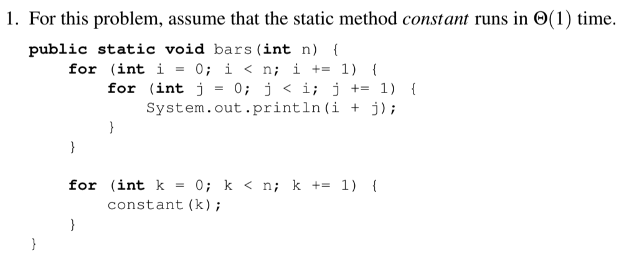
2 Practice with Runtime

Slide 9
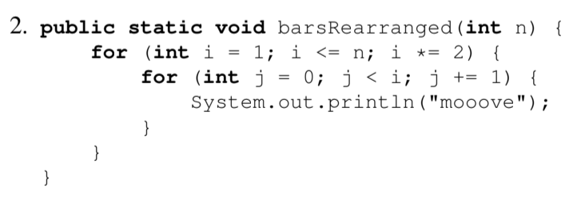
2 Practice with Runtime

Slide 10
Bits
Each number has a bit representation
01110 = 0*2⁴ + 1*2³ + 1*2² + 1*2¹ + 0*2⁰ = 14

Slide 11
Bitwise Operators
 | AND (&) | OR (|)
0 __ 0 | 0 | 0
0 __ 1 | 0 | 1
1 __ 1 | 1 | 1
x << y: shift the bit representation of x by y to the left (rest are filled with 0’s)
If x is 10011 and y is 2
x << y is 01100
x >> y: shift the bit representation of x by y to the right (rest are filled with 0’s)
If x is 10011 and y is 2
x >> y is 00100

Slide 12
3 A Bit with some Bits
Let’s figure out what this question is asking first...
Complete the following method such that it does what it is intended to do: given a list of integers, it returns an integer such that the i-th bit of the return value is 1 if and only if more than half of the integers in the list have 1 in the ith bit. Keep in mind that Java ints are 32 bits long!

